Slide 1
BIFX 503: Statistics for Bioinformatics
Instructor: Jennifer Schroeder, Ph.D.
Wednesdays, 5:30-8:00pm
Hodson Technology Center, Room 237
Fall 2021

Slide 2
Analysis of Variance (ANOVA)
One way ANOVA
Factorial ANOVA
Analysis of Covariance (ANCOVA)

Slide 3
Comparing Multiple Means
You have three or more groups you want to compare
Why not just do multiple two-sample t tests?

Slide 4
Recall Alpha
Alpha is the Type I error rate (false positive rate)
Probability of erroneously concluding that an effect is present, given many replications of the same experiment/test
Controls error in the long run
Represents the “standard of proof” that the phenomenon under study exists
Lower alpha ↔ less likely to mistake a chance finding for a real association

Slide 5
How Multiple Comparisons Inflate Alpha
If k independent hypothesis tests were done with α=0.05, we would expect 5% of them to reject H₀ even if H₀ is true
When we look at the tests in aggregate, we need to consider the simultaneous probability that H₀ will be incorrectly rejected:
P(H₀ incorrectly rejected)=1-P(H₀ not incorrectly rejected)
=1-(1-α)^{k}
If α=0.05, this is 1-0.95^{k}
For k=1, 1-0.95¹=0.05
For k=2, 1-0.95²=0.0975

Slide 6
How ANOVA Controls Alpha
The more tests you do, the more likely you are to get a significant result purely by chance
ANOVA uses a single test to stand in for multiple two-sample tests

Slide 7
One-way ANOVA

Slide 8
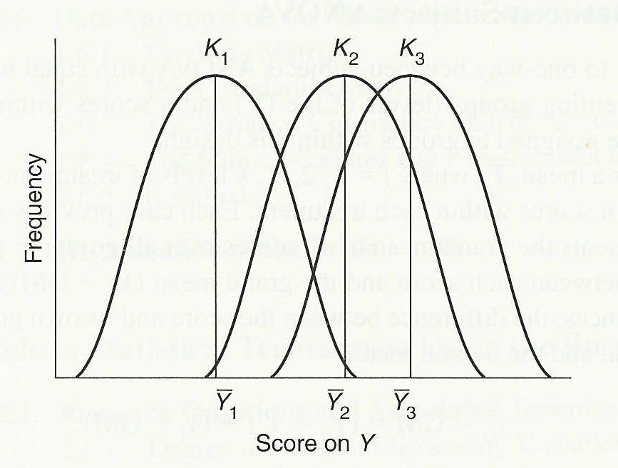
Analysis of Variance (ANOVA)
Used to compare three or more group means to see if there are any reliable differences between them
The null hypothesis is that each of the means comes from the same sampling distribution (i.e. group differences are due to random error)
Figure from Barbara Tabachnick & Linda Fidell’s Using Multivariate Statistics, 4th ed. (Allyn & Bacon, 2001) page 35.

Slide 9
Analysis of Variance
When you have more than two groups, the variance has two components:
Differences among the group means
Between groups
Differences among the subjects within each group
Within groups

Slide 10
Analysis of Variance
ANOVA calculations are based on sums of squares
Total sum of squares, SS_{T}
The sum of squared deviations between each value in the sample and the overall sample mean (grand mean)
Within groups sum of squares, SS_{W}
The sum of squared deviations between each value in the group and the group mean, summed over all groups
Between groups sum of squares, SS_{B}
The difference, SS_{B} = SS_{T} - SS_{W}

Slide 11
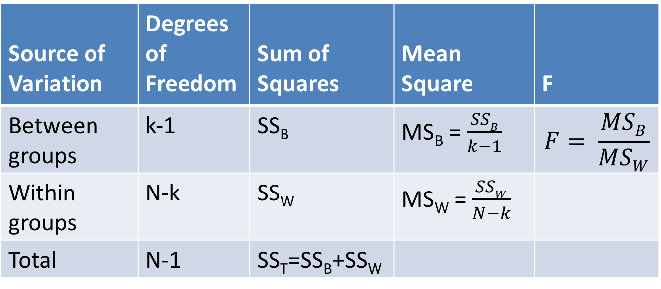
ANOVA Table
Source of Variation | Degrees of Freedom | Sum of Squares | Mean Square | F
Between groups | k-1 | SS_{B} | MS_{B} = $\frac{SSB}{k−1}$ | $$F= \frac{MSB}{MSW}$$
Within groups | N-k | SS_{W} | MS_{W} = $\frac{SSW}{N−k}$
Total | N-1 | SS_{T}=SS_{B}+SS_{W}
Where k is the number of groups, and N is the total sample size (all groups combined)

Slide 12
Assumptions and Conditions
Independence: between and within groups
Random samples are evidence of independence
Nearly Normal distribution
Must be checked for all groups
n < 15: must be very close to normal
15 ≤ n ≤ 40: check for outliers and skewness
n > 40: fine as long as no extreme outliers or extreme skewness

Slide 13
Hypotheses
Null and Alternative
H₀: means are all equal
E.g., H₀: μ₁ = μ₂ = μ₃
H_{A}: means are not all equal
One- or two-sided
Two-sided: no direction (≠)
One-sided: direction of change is specified (> or <)

Slide 14
Probability Model
The F distribution
Named for Fisher, inventor of ANOVA
Asymmetric distribution
Shape depends on degrees of freedom (df)
Numerator and denominator (df)

Slide 15
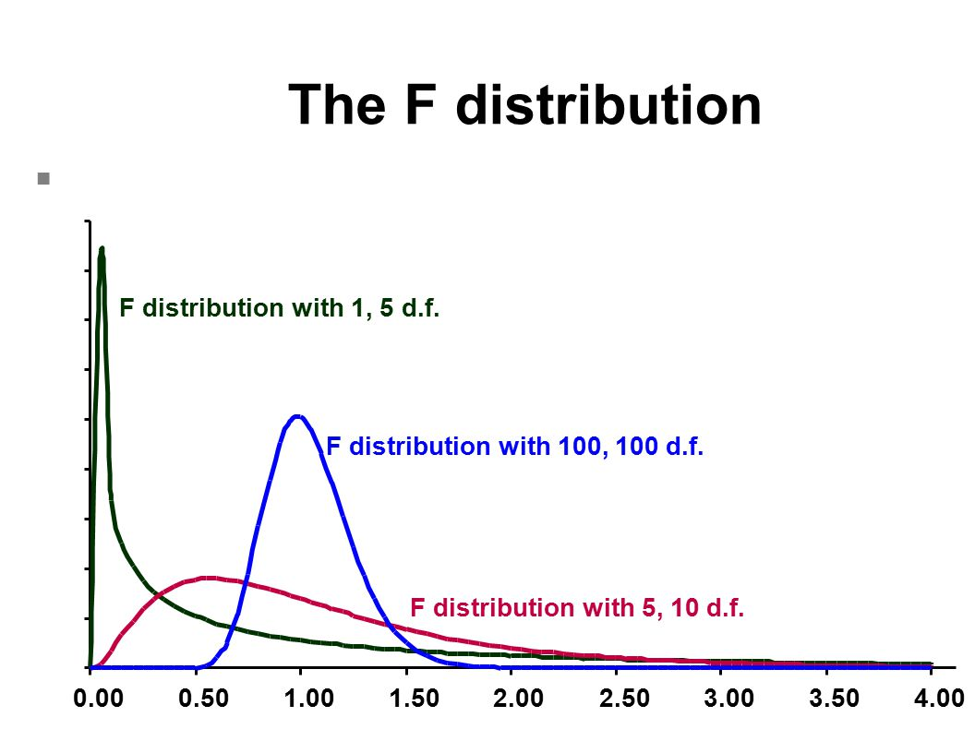
F distribution

Slide 16
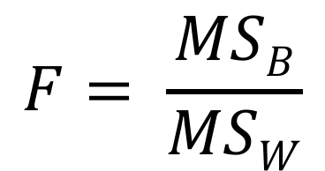
The F Statistic
$$F= \frac{MSB}{MSW}$$
The test statistic, F, is the ratio of the two mean squares
F will be large if the between-group variability is large compared to the within-group variability
In other words, if members of a group are more like each other than like members of the other groups
Large F → small p value

Slide 17
Decision
Calculate the F statistic and its corresponding p-value
If p<0.05 (or significance level you set a priori), reject H₀, conclude means are different

Slide 18
ANOVA in R
aov(variable ~ group, data)
Variable refers to the variable you want to test
Group defines the different groups
Data is the dataframe the variables are in
summary(aov(variable ~ group, data))
Output for full ANOVA table
Sums of squares, degrees of freedom, F test

Slide 19
Example 1: Chicken Diets
Data chickwts
71 newly hatched chicks are randomly assigned to six experimental groups, each group is given a different feed supplement
Chick weights (g) assessed after six weeks
Are weights the same for the six feed supplements?
Hypotheses
H₀: μ₁ = μ₂ = μ₃ = μ₄ = μ₅ = μ₆
H₁: The mean weights of chicks on the six diets are not all equal

Slide 20
Example 1: Chicken Diets
Histogram to check distribution
Reasonably normal
Boxplots to visualize how the means differ by group, and group distributional shape
Weight seems to vary by feed type
Casein and sunflower highest weight
ANOVA to test for group difference
Effect of feed is highly significant p<.05
Confirms what we see in the boxplot

Slide 21
Example 2: Plant Growth
Data PlantGrowth
Results from experiment to compare yields obtained for control and 2 treatments
Dried plant weight is outcome
Are weights the same for the treatments?
Hypotheses
H₀: μ₁ = μ₂ = μ₃
H₁: The mean weights of chicks on the six diets are not all equal

Slide 22
Associations Between Three or More Variables
Frequently a third variable is of scientific interest
You want to see how a third variable affects the relationship between the other two variables
Interaction
Factorial ANOVA can detect interaction
You want to assess the relationship between two variables while holding a third variable constant
Confounding
ANCOVA can correct confounding

Slide 23
Factorial ANOVA

Slide 24
Factorial ANOVA
When an experiment has two or more independent variables (a.k.a. factors), it is known as a factorial design
Factors are crossed with each other
All combinations of factors are included in the design
Every level of each factor occurs in combination with every level of the other factors
Interaction between the variables is frequently the primary scientific interest

Slide 25
Types of Factorial Designs
Independent or Between-Subjects Design
Each IV or factor is composed of different study subjects
E.g. you randomize subjects to receive one treatment or another
Repeated or Within-Subjects Design
The same study subjects are assessed at different levels of the IV or factor
E.g. each subject receives different treatments given in random order
Mixed Design
Each IV or factor is composed of different study subjects, but they are assessed repeatedly
E.g. you randomize subjects to receive one treatment or another, but you assess their response repeatedly to see if the rate of response differs between groups

Slide 26
Factorial ANOVA Example
Study of medication efficacy varying
Dose (low, high) and
Delivery method (oral, inhaled)
2 x 2
Four treatment combinations
Low-oral
High-oral
Low-inhaled
High-inhaled

Slide 27
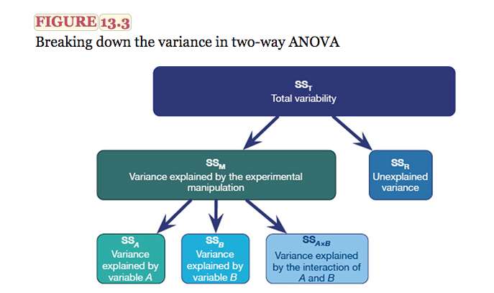
Factorial ANOVA
From Andy Field’s Discovering Statistics Using IBM SPSS-Statistics 4th ed.

Slide 28
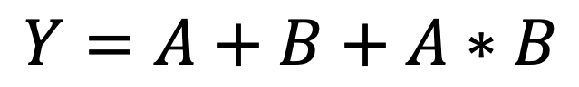
Factorial ANOVA Model
$$Y=A+B+A∗B$$
Y = outcome or response variable
Dependent variable
A and B are the factors manipulated in the experiment
Independent variable
A*B is the interaction between A and B

Slide 29
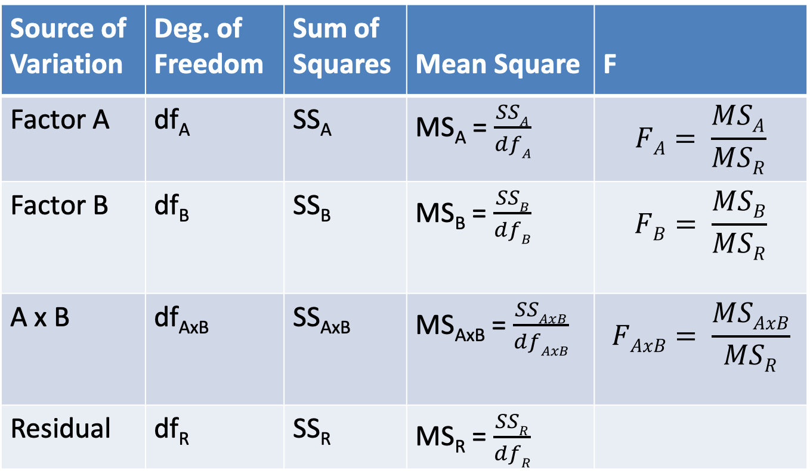
Factorial ANOVA Table
Source of Variation | Deg. of Freedom | Sum of Squares | Mean Square | F
Factor A | df_{A} | SS_{A} | MS_{A} = $\frac{SSA}{dfA}$ | $$FA= \frac{MSA}{MSR}$$
Factor B | df_{B} | SS_{B} | MS_{B} = $\frac{SSB}{dfB}$ | $$FB= \frac{MSB}{MSR}$$
A x B | df_{AxB} | SS_{AxB} | MS_{AxB} = $\frac{SSAxB}{dfAxB}$ | $$FAxB= \frac{MSAxB}{MSR}$$
Residual | df_{R} | SS_{R} | MS_{R} = $\frac{SSR}{dfR}$
The degrees of freedom for each factor is the number of scores minus 1 for that factor

Slide 30
Assumptions and Conditions
Independence
Homogeneous variance
Nearly Normal distribution

Slide 31
Factorial ANOVA in R
aov(variable ~ A + B, data)
Main effects only
Factors A and B
aov(variable ~ A*B, data)
Main effects and interaction
Factors A and B

Slide 32
Alternative Method: LM
mod1 <- lm(variable ~ A + B, data)
mod2 <- lm(variable ~ A*B, data)
anova(mod1, mod2)
Partial F test
Does interaction term improve model fit?

Slide 33
Understanding Interactions

Slide 34
Main Effects & Interactions
Main Effects
Based on marginal means
Effect of Factor A ignoring Factor B and vice versa
Interactions
Based on cell means
The effect of A at each level of B

Slide 35
Testing for Interaction
Run the factorial ANOVA model, what you do next depends on the significance of the interaction term
If interaction is statistically significant (p<0.05)
If interaction is not statistically significant (p>0.05)
Interpreting main effects is difficult
Main effects are not independent of each other
Do a simple main effects analysis to understand what’s driving the significant interaction
Evaluate each main effect as you would for one-way ANOVA
You may want to re-run the ANOVA without the interaction term (main effects only)

Slide 36
Exploring Interactions
Make an “interaction plot” that shows how the effect of one factor on the outcome varies as a function of the other factor
Parallel lines indicate that interaction is probably not present
Lines that are not parallel, or lines that cross, indicate that interaction probably is present
The statistical significance of the interaction term confirms the presence of interaction

Slide 37
Interaction Plots in R
interaction.plot()
Arguments
x.factor: x axis variable
trace.factor: grouping variable
response: y axis variable
fun: summary function (e.g., mean)
type: “l” lines, ”p” points, “b” both

Slide 38
Other Plots in R
Also helpful for visualizing interactions:
Box plots
Lattice plots
boxplot(y ~ A + B, data)
xyplot(y ~ A | B, data)

Slide 39
Simple Main Effects Analysis
If interaction is present, do simple main effects analysis to determine the nature of the interaction
Test the effect of factor A at each level of B and vice versa
This is a form of multiple testing, so some form of p-value correction should be used

Slide 40
Simple Main Effects Analysis in R
Run ANOVA model and save to variable
Run the Tukey HSD procedure on the output variable from the ANOVA model
aov.out <- aov( Y ~ A*B, data)
TukeyHSD(aov.out)
plot(TukeyHSD(aov.out))

Slide 41
Tables of Means
model.tables(aov.out, type=“means”, se=TRUE)
To see cell means and SE’s
For each factor combination

Slide 42
Example 3: Tooth Growth
Data ToothGrowth
Effects of Vitamin C on the tooth growth of guinea pigs
60 guinea pigs
Each received one of three doses of Vitamin C
0.5, 1.0, or 2.0 mg/day
Each had one of two delivery methods
Orange juice (OJ) or ascorbic acid (VC)
Outcome: length of odontoblasts

Slide 43
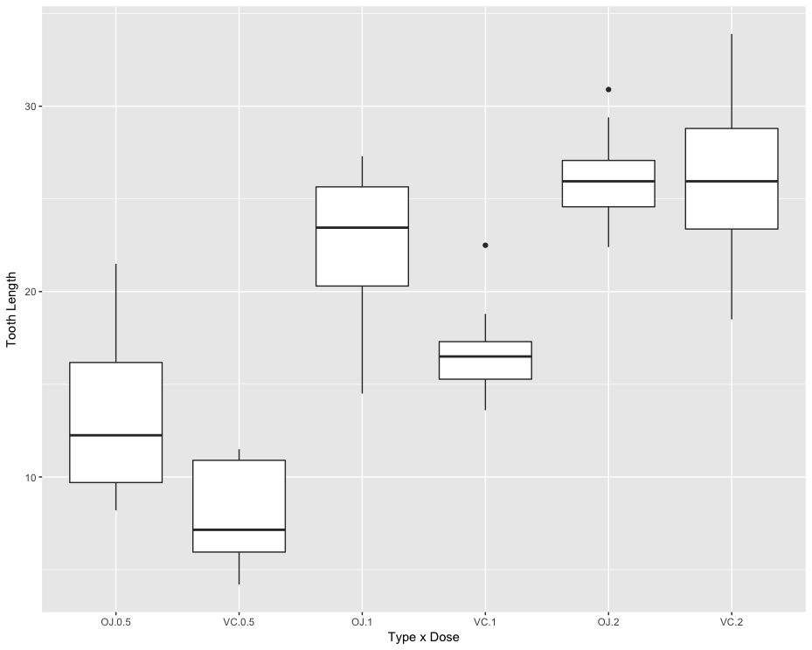
Type x Dose Interaction

Slide 44
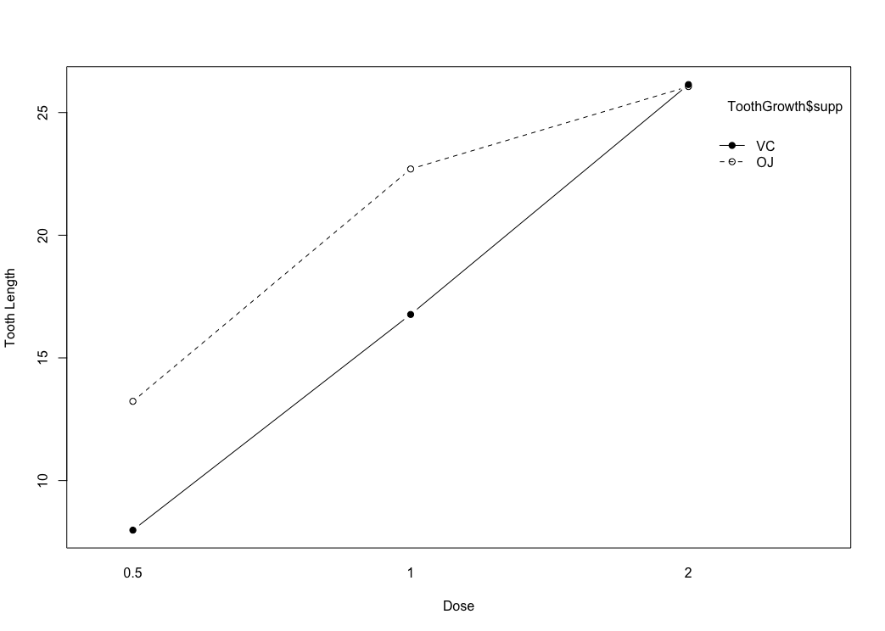
Interaction Plot

Slide 45
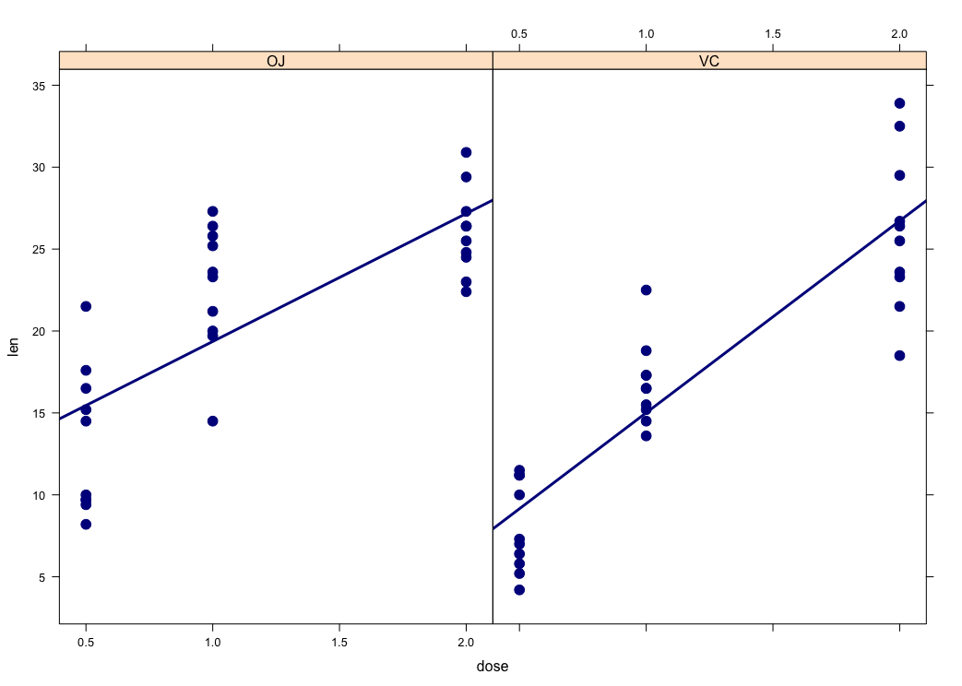
Lattice Plot

Slide 46
Box Plot with Interaction (ggplot)

Slide 47
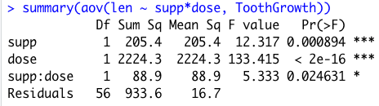
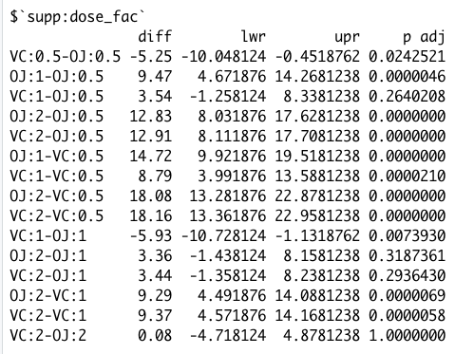
Results for Tooth Growth
Main effects and interaction significant
Interaction exists (p=0.025)
Simple main effects analysis
Look at lines where dose is same but supp is different
VC 0.5 – OJ 0.5
VC 1.0 – OJ 1.0
VC 2.0 – OJ 2.0
Effect of Supp was significant at lower doses but not at highest dose

Slide 48
Example 4: Rat Pup Weight Gain
Data genotype (from MASS package)
Rat litters were separated from their natural mothers at birth and given to foster mothers to rear
Do rat pups raised by mothers of a different genotype differ from those raised by mothers of the same genotype in terms of weight gain?
Evaluate the effects of litter genotype and foster mother genotype on rat pup weight gain
Interaction plot
Main effects & interactions

Slide 49
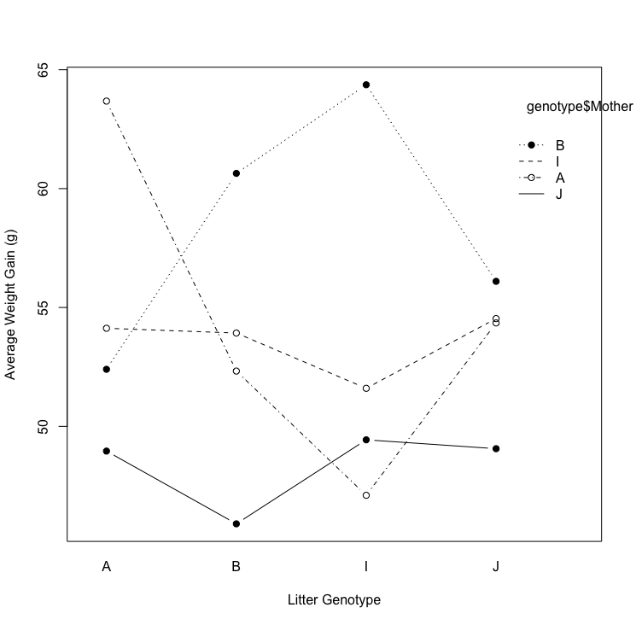
Interaction Plot for Rat Pups
This plot shows no clear evidence of interaction

Slide 50
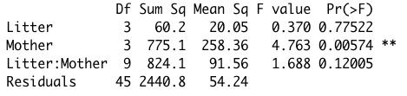
Results for Rat Pups
Interaction model showed no significant interaction (p=0.12)
Simple main effects analysis not necessary
Main effects model showed significant effect of maternal genotype (p<0.01), but no significant effect of litter genotype (p=0.80)

Slide 51
Effect of Mother Greater Than Litter
Mother “J” produces lower-weight pups regardless of litter

Slide 52
Analysis of Covariance (ANCOVA)

Slide 53
Analysis of Covariance (ANCOVA)
When you add a “covariate” variable to an ANOVA it becomes an ANCOVA
Evaluates the effect after adjusting for the covariate
Often it makes sense to include a subject’s baseline value as a covariate
This evaluates the effect of the experimental treatment after accounting for pre-existing differences among subjects

Slide 54
ANCOVA in R
aov(variable ~ A + B + X, data)
Main effects only
Factors A and B
Covariate X
aov(variable ~ X + A*B, data)
Main effects and interaction
Covariate X

Slide 55
Example 5: Cholesterol
Does a certain brand of margarine reduce cholesterol as part of a low-fat, low-cholesterol diet?
18 subjects
Randomized to receive margarine type A or B
Cholesterol measured at three time points:
Before the study
After 4 weeks
After 8 weeks

Slide 56
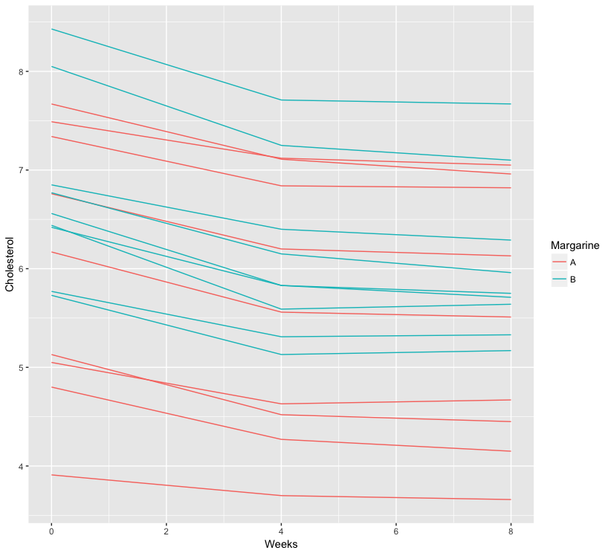
Cholesterol Change

Slide 57
Controlling for Baseline
Ignore baseline differences -- no treatment effect
High @BL: no treatment effect
Low @BL: A < B at 8 weeks

Slide 58
Example 5: Cholesterol
Model including treatment effect alone
Model including treatment effect plus baseline cholesterol as covariate
Treatment effect becomes significant after adjusting for baseline cholesterol level
aov(chol.8weeks ~ tx, chol)
aov(chol.8weeks ~ tx + baseline.chol, chol)

